Slide 1
Chongqing University of Technology
ATAI
Advanced Technique of Artificial Intelligence
Chongqing University of Technology
Handling Information Loss of Graph Neural Networks for Session-based Recommendation（KDD_2020）
Tianwen Chen
tchenaj@cse.ust.hk
The Hong Kong University of Science and Technology
Clear Water Bay, Kowloon, Hong Kong
Raymond Chi-Wing Wong
raywong@cse.ust.hk
The Hong Kong University of Science and Technology
Clear Water Bay, Kowloon, Hong Kong
2021.1.31 • ChongQing
Reported by LeLe Duan
Code&dataset:https://github.com/twchen/lessr

Slide 2
Chongqing University of Technology
ATAI
Advanced Technique of Artificial Intelligence
Chongqing University of Technology
1.Background
2.Method
3.Experiments
4.Conclusion

Slide 3
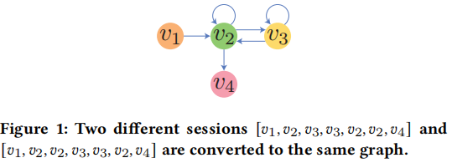
Background
Two problem of Session-based Recommendation:
Lossy session encoding problem.
Ineffective long-range dependency capturing problem.

Slide 4
Method
Overview of model LESSR
S2MG:Converting sessions to Edge-order preserving (EOP) multigraphs
S2SG:Converting sessions A short-cut graphs

Slide 5
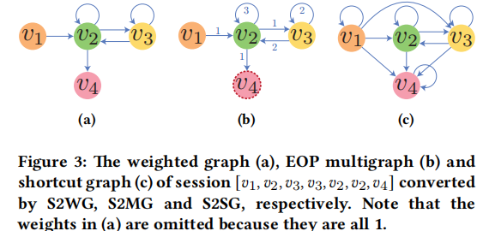
Method
Problem Definition
The universal set of items
The objective of the model is to predict the next item
Converting Sessions to Graphs

Slide 6
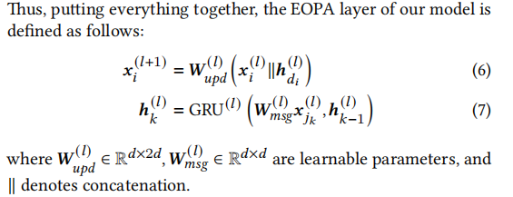
Method
Edge-Order Preserving Aggregation (EOPA) Layer

Slide 7
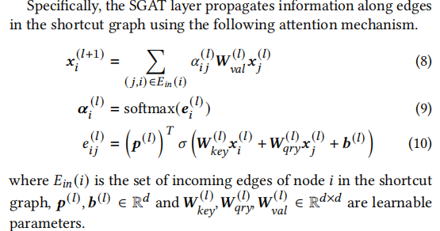
Method
Shortcut Graph Attention (SGAT) Layer

Slide 8
Method
Readout & $S_{h}$ Layer
Let denote the final node representation of the last item in the session. The graph-level representation is defined as follows:

Slide 9
Method
Prediction and Training

Slide 10
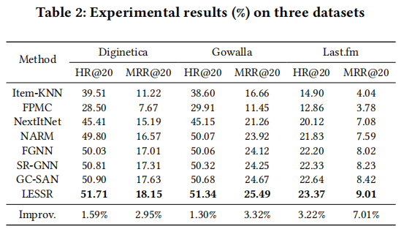
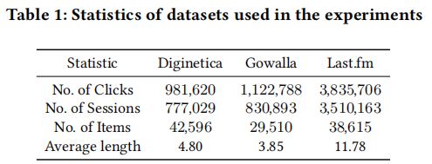
Experiment
Overall experiment

Slide 11
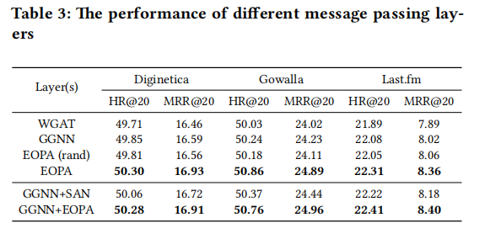
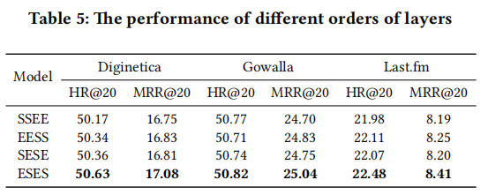
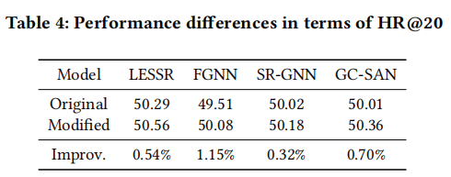
Experiment
Effectiveness of EOPA Layer.
Order of EOPA and SGAT Layers
Effectiveness of SGAT Layer

Slide 12
Experiment
Hyper-parameter Study

Slide 13
Chongqing University of Technology
ATAI
Advanced Technique of Artificial Intelligence
Chongqing University of Technology
Thank you!

